Slide 1

2021 Hackathon
COWCULATOR

Slide 2

Hello!
We’re Team Cowculator from UCI Paul Merage School of Business.

Slide 3
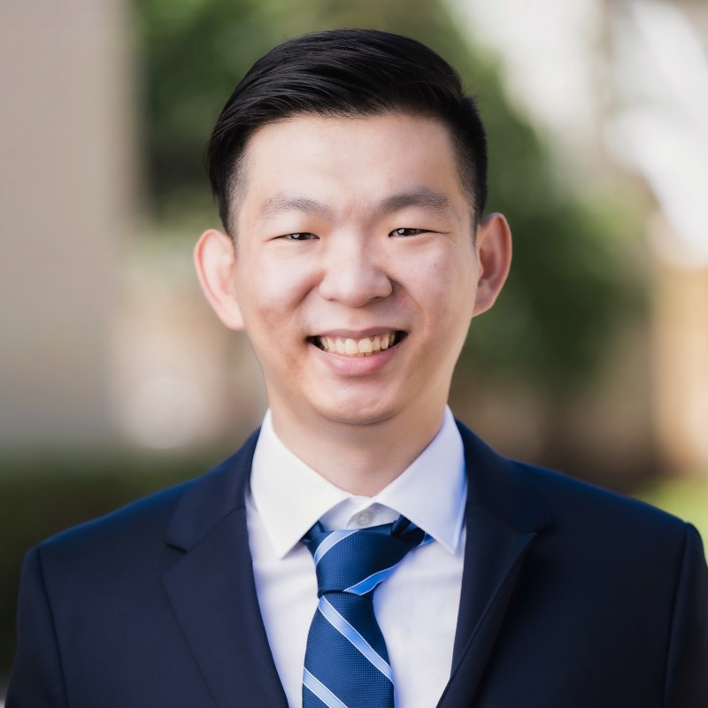

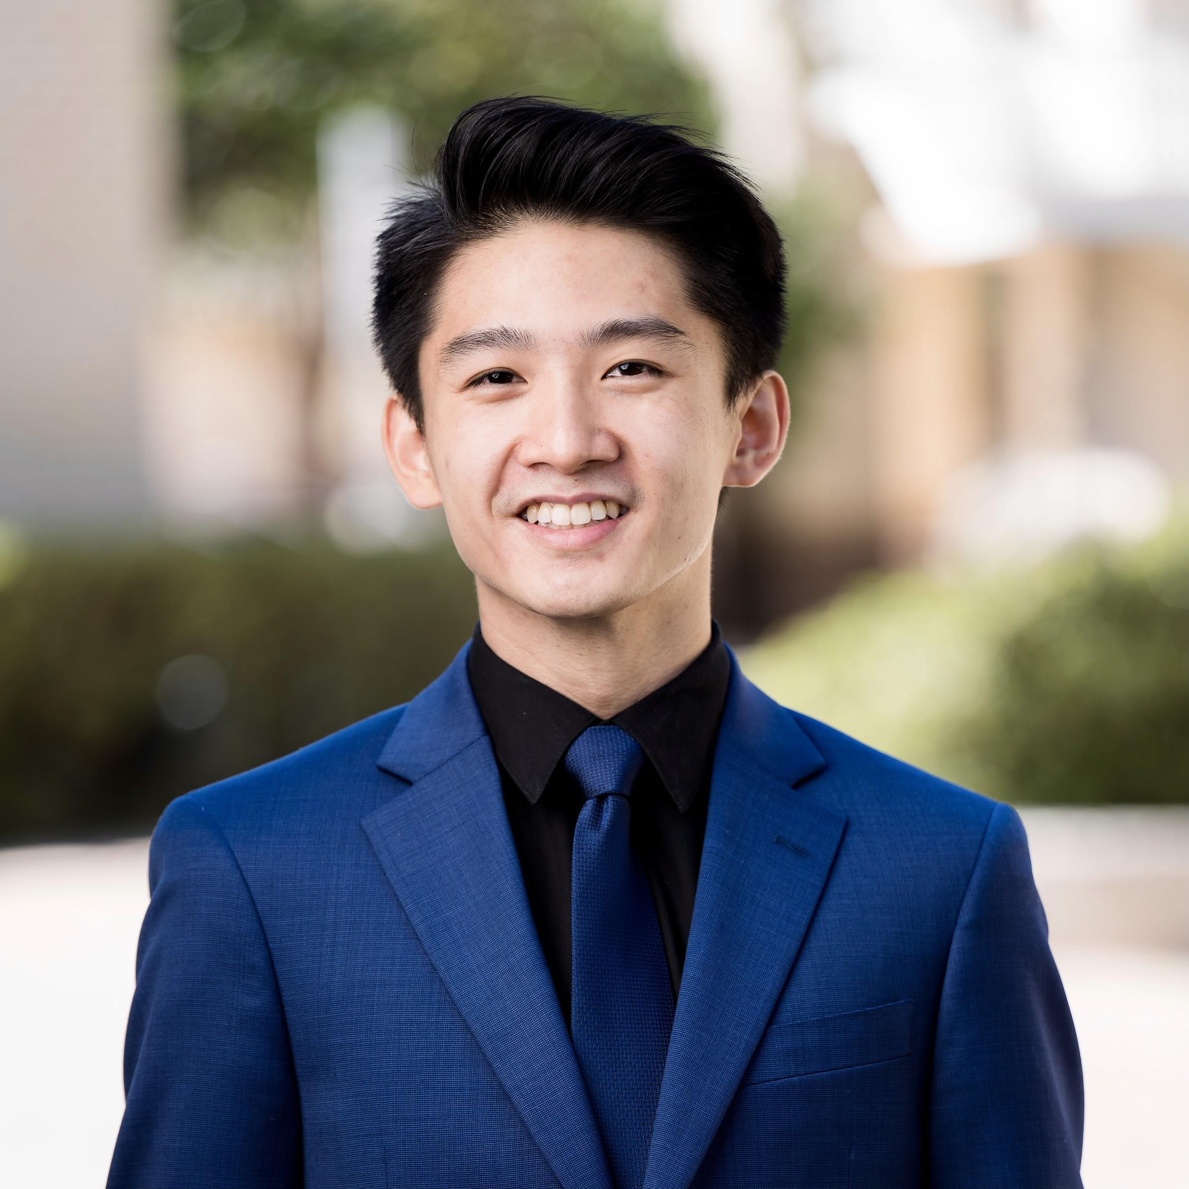

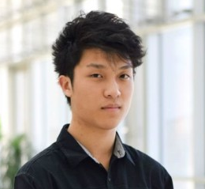
Team Presentation
Andrew Xiao
Sally Nguyen
Samson Truong
Han Mai
Brian Kosiadi

Slide 4
Objective
1

Slide 5
To offer a carbon footprint estimate of farms based on acres and animals.

Slide 6
Project Summary
FOCUS: agriculture - one of the greatest contributors of greenhouse gas emissions.
GOAL: Bring awareness to farmers about their carbon footprint
ACTION PLAN: Estimate footprint per farmer and offer up recommendations for sustainability

Slide 7
Data Wrangling
1. Gather Agricultural Data Across the US
2. Research Amount of Greenhouse Gases Produced by Animals
3. Calculate Total Amount of Emissions Based on Land Acreage and Animal Headcount

Slide 8
Gathered From
US County Farm Data
CO2 emission
N2O emission
CH4 emission
Meat Conversion Rate

Slide 9
Visualizations
2

Slide 10
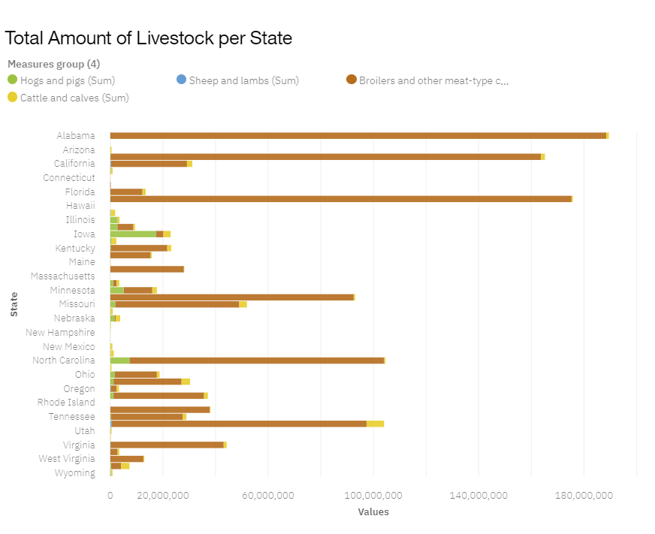

Slide 11
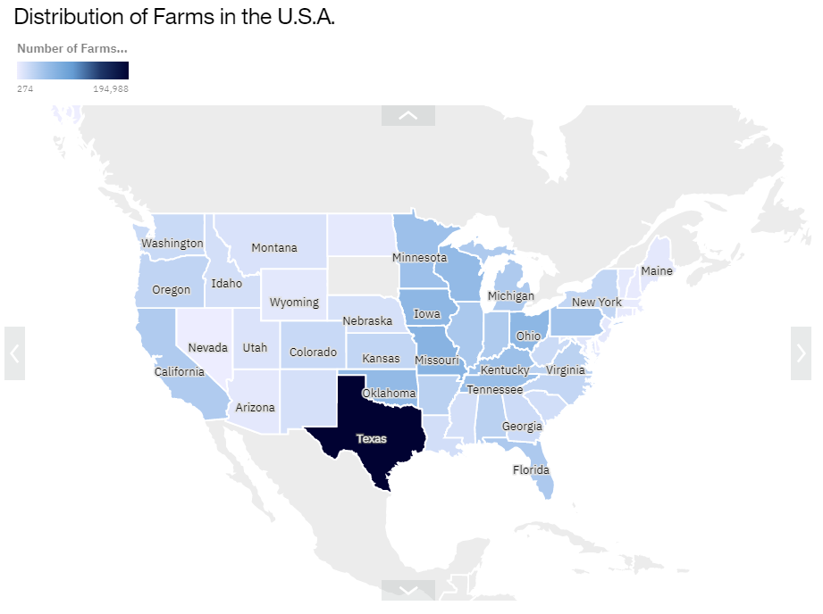
MAP

Slide 12
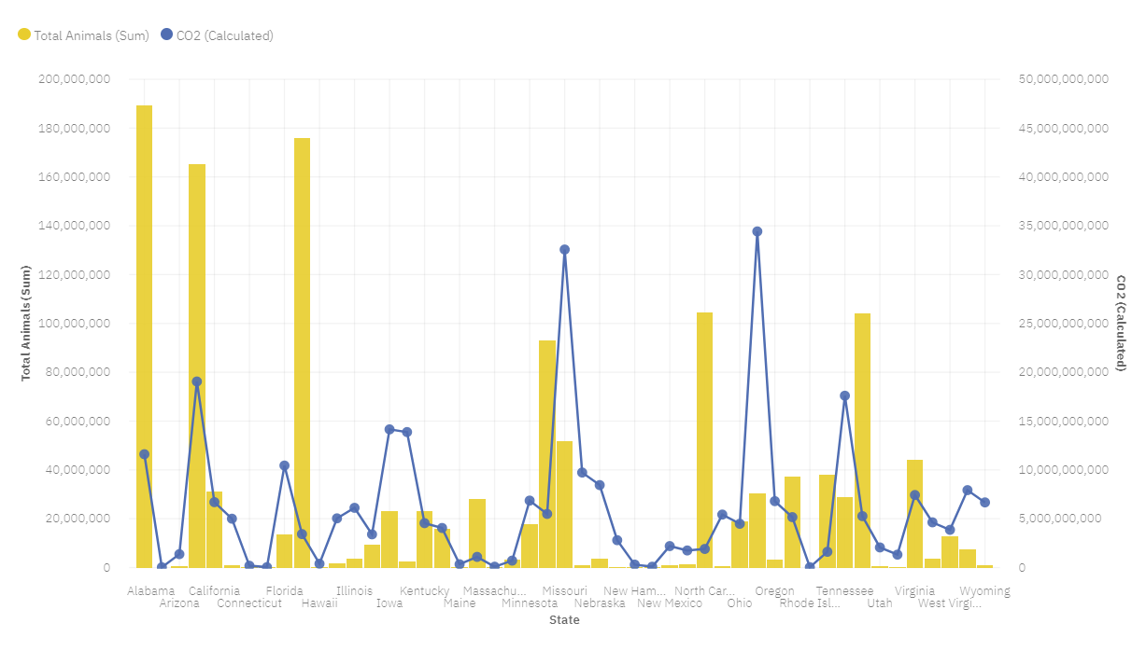
CO2

Slide 13
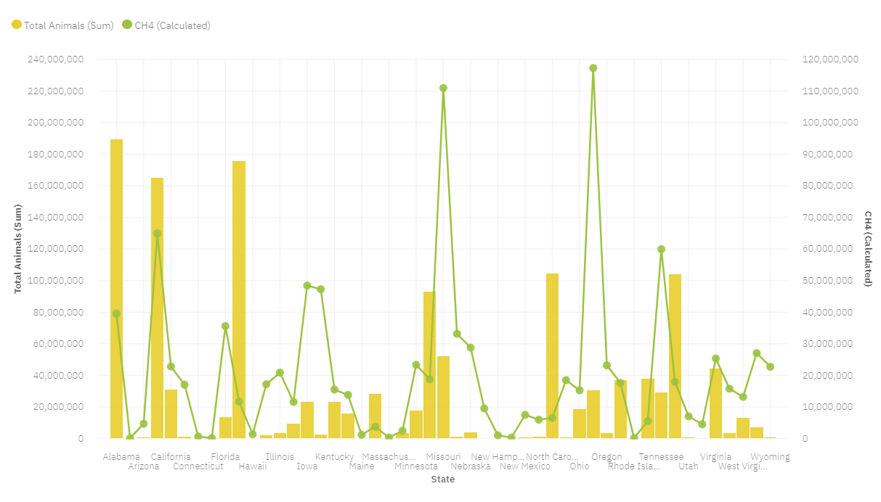
CH4

Slide 14
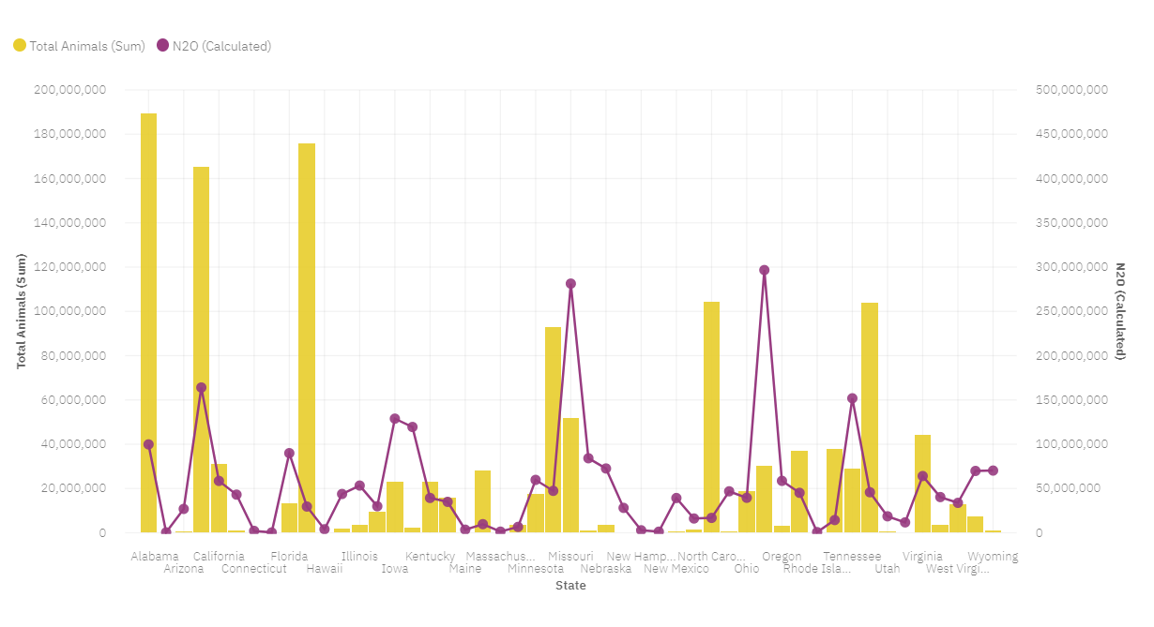
N20

Slide 15
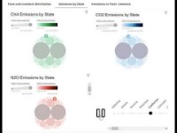

Slide 16
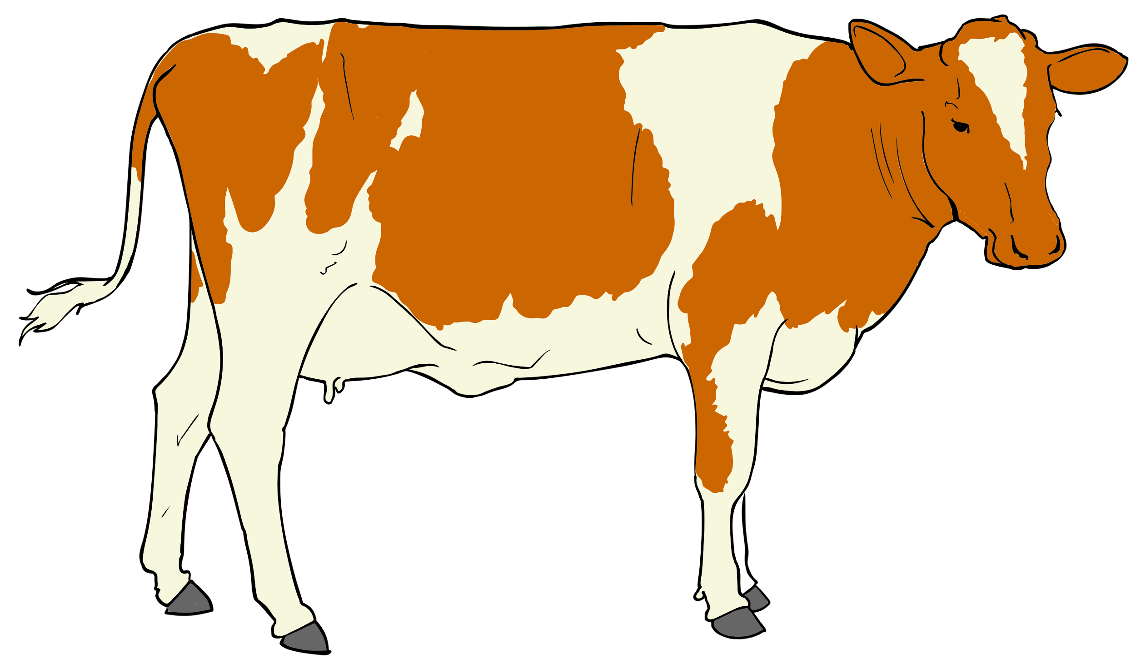
USER INTERFACE

Slide 17
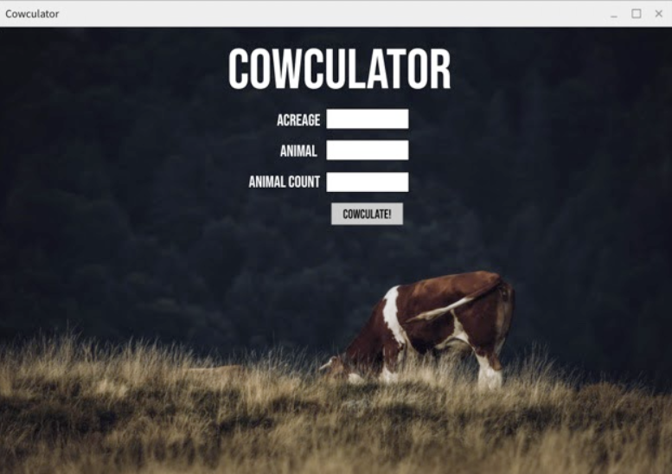

Slide 18
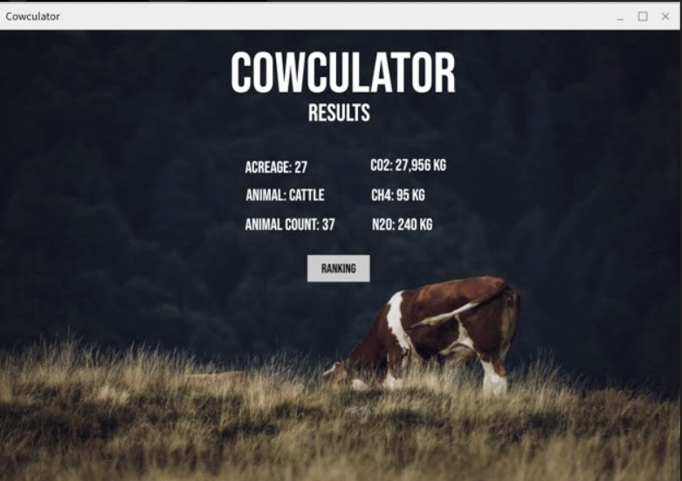

Slide 19
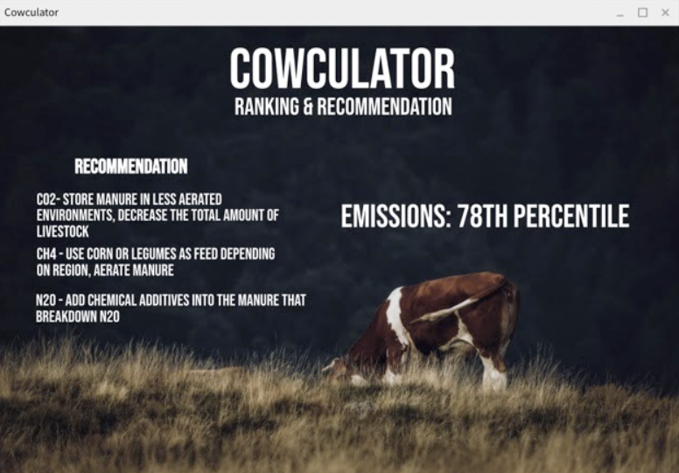

Slide 20
Website Framework
Enter Website
Input Acreage
Input Livestock
Use formulas obtained from EPA/research
Calculate estimate of greenhouse emissions

Slide 21
53,655,534kg
Cumulative Emissions per year accounting for all livestock
RESULTS

Slide 22
51,124,503 kg/year
2,290,627 kg/year
240,404 kg/year
CO2
N2O
CH4

Slide 23
Recommendations
3

Slide 24
We recommend...
If you want to target lowering :
Manage the overhealth of the livestock through
CH4 - Use corn or legumes as feed depending on region, aerate manure
CO2- Store manure in less aerated environments, decrease the total amount of livestock
N2O - Add chemical additives into the manure that breakdown N2O

Slide 25
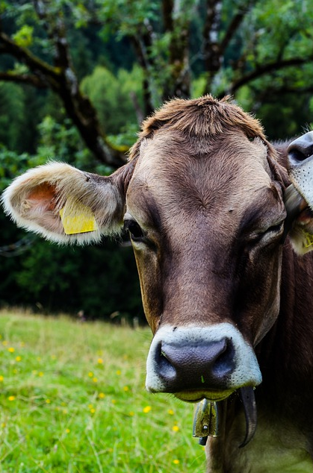
Thanks!
Any questions?

